Slide 1
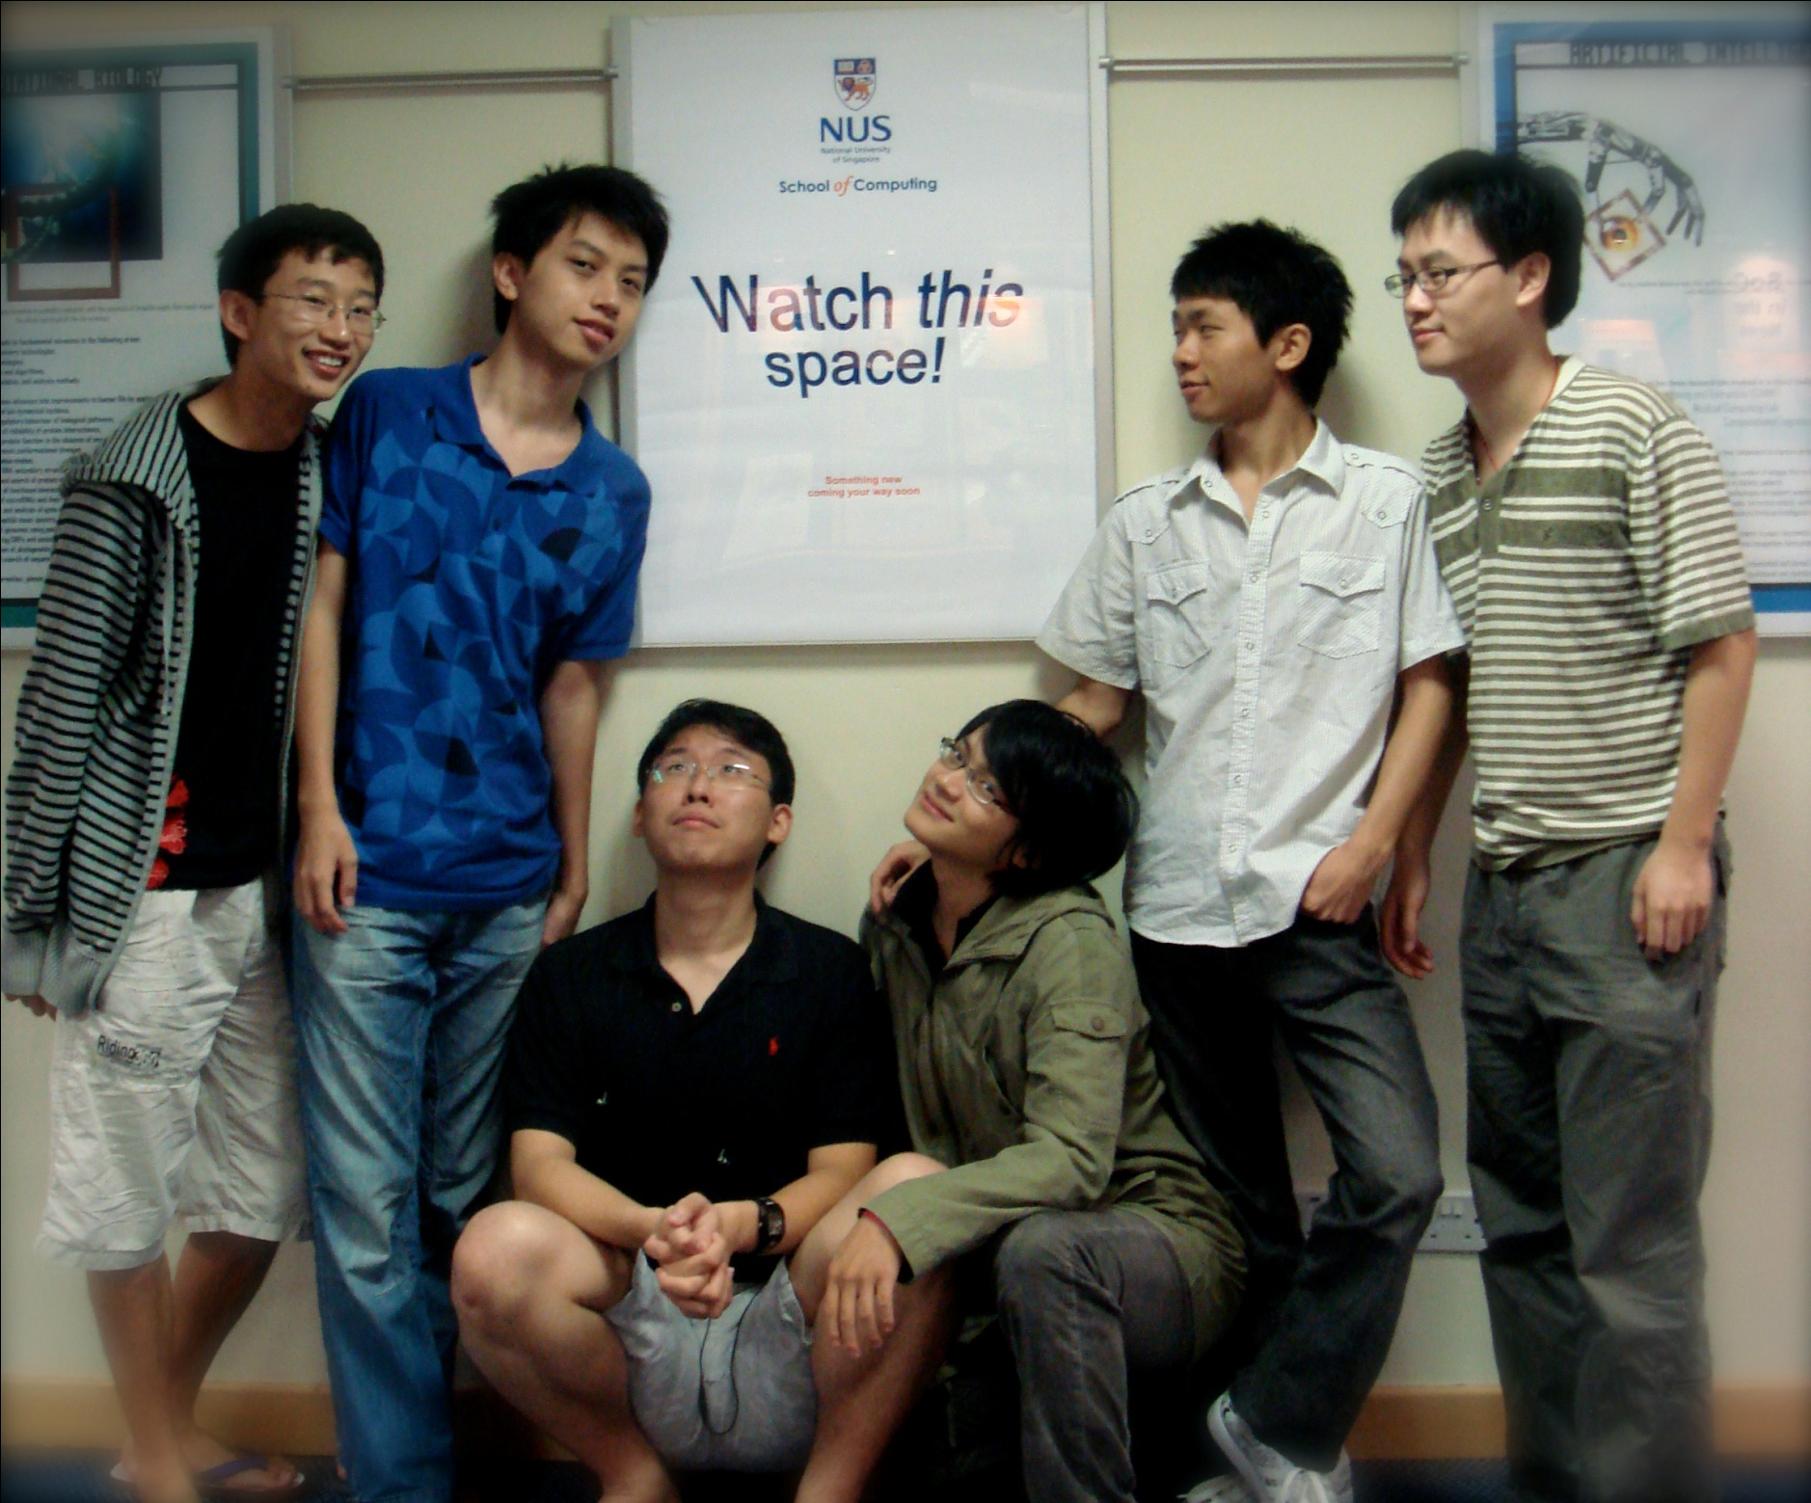
How to work individually effectively in a team setting
Lessons learnt from CS3215
Lightning Talk
0110

Slide 2
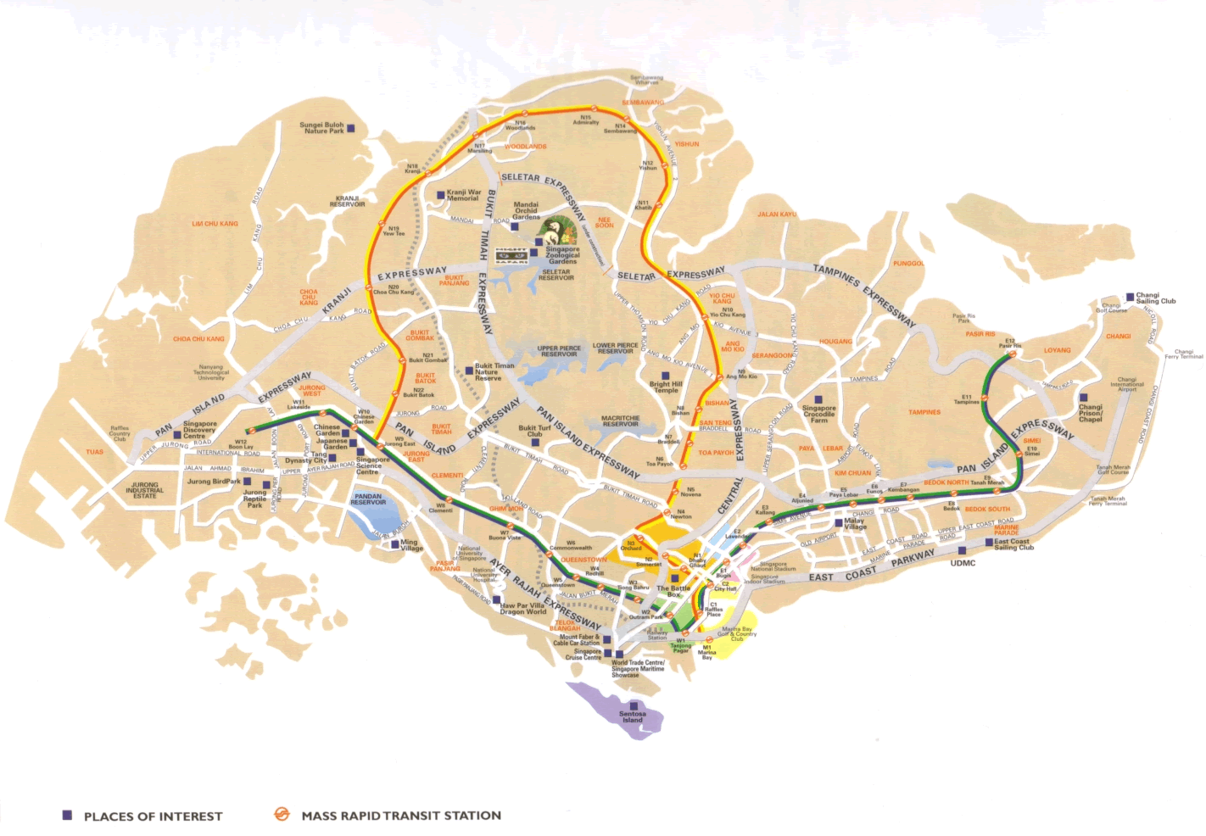



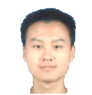



Slide 3
Purpose

